Slide 1
Cardiovascular Disease Analysis
BY: TRAVIS BLANTON

Slide 2
The Database
Cardiovascular Disease Dataset
70,000 patient records
11 features + 1 target result (cardio)
Added BMI
Changed to US metrics (years, lbs, inches)
Objective: ex. Age
Examination: ex. Glucose
Subjective: ex. Smoke
Statistical Analysis
T-test – Continuous data
Z-test – Binary data
Assume a 95% confidence Interval

Slide 3
The Results
Biggest Contributors of Cardiovascular Disease
BMI
Male vs Female
Blood Pressure
Cholesterol
Glucose
Age
Patients over 53 years old

Slide 4
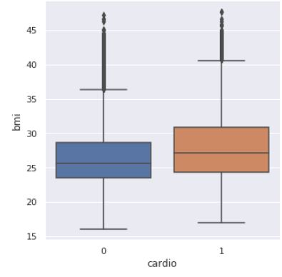
BMI
What is Body Mass Index?
Split into two groups
BMI <= 25
BMI > 25
P-Value: The difference is significant at p < .05
Cohens D: 2.37

Slide 5
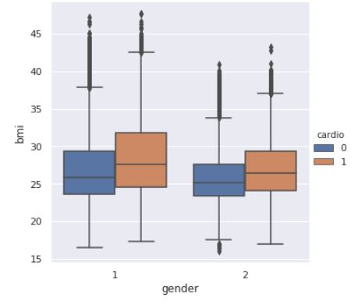
Overweight Males & Overweight Females
Males (2)
BMI > 25 vs BMI <=25
P-Value: The difference is significant at p < .05
Standard Deviations: 21.48
Females (1)
BMI > 25 vs BMI <=25
P-Value: The difference is significant at p < .05
Standard Deviations: 25.87

Slide 6
Blood Pressure
Split data
Regular BP
High BP
P-Value: Significant at p < .05
High blood pressure: 84%
Regular blood pressure: 35%

Slide 7
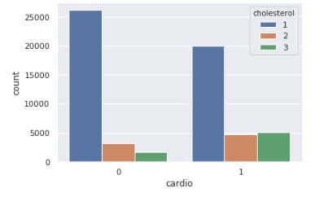
Cholesterol
What is Cholesterol?
Split the data
Normal cholesterol (1)
Abnormal cholesterol (2&3)
P-value is significant at p < .05
Abnormal cholesterol – 67%
Normal cholesterol – 43%

Slide 8
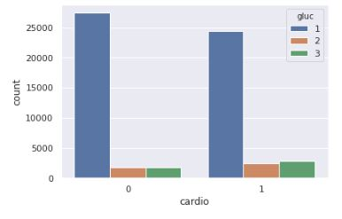
Glucose
What is Glucose?
Split data
Normal glucose (1)
Abnormal glucose (2&3)
P-value is significant at p < .05
Abnormal glucose – 59%
Normal glucose – 47%

Slide 9
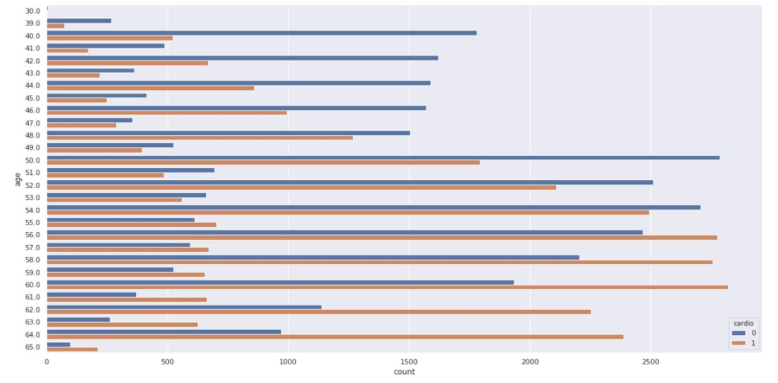
Age

Slide 10
BMI in People Over 53
BMI > 25 vs BMI <=25
Patients over 53 years old
P-Value: Significant at p < .05
Overweight & older than 53: 62%
Normal weight & older than 53: 50%

Slide 11
Cholesterol in People Over 53
Normal Cholesterol vs High Cholesterol
Patients over 53 years old
P-Value: Significant at p < .05
High Cholesterol & older than 53: 71%
Normal Cholesterol & older than 53: 53%

Slide 12
Glucose in Patients Over 53
Normal Glucose vs High Glucose
Patients over 53 years old
P-Value: Significant at p < .05
High Glucose & older than 53: 65%
Normal Glucose & older than 53: 56%

Slide 13
Conclusion
Biggest factors:
Elevated Blood Pressure, BMI, Cholesterol, Glucose, and Over the Age of 53
Future research suggestions:
More continuous variables vs binary
Leads to more specific testing
All age groups
Where this can take us:
Predictive software for medical diseases
Patient portal with flags

